Slide 1
Transactions and Recovery:
Lock-Based Concurrency Control

Slide 2

Objectives
Objective
Explain Transactions and Concurrency Control concepts

Slide 3
Lock-Based Concurrency Control
Strict Two-phase Locking (Strict 2PL) Protocol:
  Each transaction must obtain a Shared lock on object before reading, and an exclusive lock on object before writing.
  All locks held by a transaction are released when the transaction completes
Strict 2PL allows only serializable schedules.
  it simplifies transaction aborts

Slide 4
Lock Management
Lock and unlock requests are handled by the lock manager
Locking and unlocking have to be atomic operations
Lock upgrade
  transaction that holds a shared lock can be upgraded to hold an exclusive lock
Lock Entry Table
Client | Lock Mode | Lock Argument
Notes:
Lock table entry:
Number of transactions currently holding a lock
Type of lock held (shared or exclusive)
Pointer to queue of lock requests

Slide 5
Deadlocks
Deadlock
  Cycle of transactions waiting for locks to be released by each other.
Deadlock Detection
Create a waits-for graph:
  Nodes are transactions
  There is an edge from Ti to Tj if Ti is waiting for Tj to release a lock
Periodically check for cycles in the waits-for graph

Slide 6
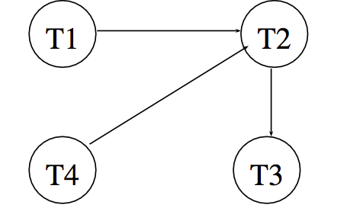
Deadlock Detection
T1: S(A), R(A), S(B)
T2: X(B),W(B) X(C)
T3: S(C), R(C)
T4: X(B)

